Slide 1
WINTER DRIVING
“PREPARE FOR SEVERE WEATHER!”

Slide 2
PREPARE FOR WINTER WEATHER
Wipers - Good working order
Windshield Washer Fluid - Fill Up
Anti-freeze - 50% water 50% Coolant
Battery & Belts - Check condition
Oil - Replace your oil with Winter grade oil
Tires - Check treads, pressure and owners
manual recommendations
Ice Scraper - A necessity

Slide 3

BEFORE TRIPS: PACK WINTER
CAR KIT
SNOW BRUSH W/ SCRAPER
FLASHLIGHT W/ BATTERIES
BLANKET
MITTENS, SOCKS & HAT
SMALL SHOVEL
SACK OF SAND OR KITTY LITTER
JUMPER CABLES
HAZARD SIGN, FLARES OR FLAG
WINDSHIELD WASHER FLUID

Slide 4
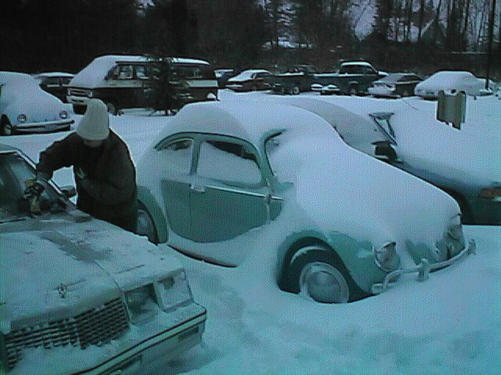
WARM-UP AND CLEAN-OFF
1. IDLE ENGINE - DO NOT RACE ENGINE!
2. CLEAN OFF VEHICLE COMPLETELY!
- CLEAN ALL LIGHTS
- SCRAPE ALL WINDOWS AND MIRRORS
- SWEEP ALL THE SNOW OFF THE VEHICLE
Good all around visibility is important!!!!!
remember, BEING IN A HURRY WILL RESULT IN ACCIDENTS DOWN THE ROAD!

Slide 5
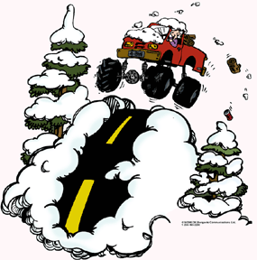
RISK MANAGEMENT DRIVING DECISIONS
Is my car equipped for the weather?
Can I make this trip later?
What would be the safest route?
Am I prepared for emergencies?

Slide 6
DECEMBER 23, 1998: SERVICE MEMBER DEPARTED FORT HOOD DURING A WINTER WEATHER WARNING. FALLING SNOW MIXED WITH SLEET. ROADS PREDICTED TO HAVE SEVERE ICING. WHILE PASSING AN EIGHTEEN WHEELER ON I-35, SERVICE MEMBER LOST CONTROL OF HIS VEHICLE AND STRUCK A BRIDGE GUARDRAIL, THEN VEERED INTO THE PATH OF THE EIGHTEEN WHEELER. THE SOLDIER WAS KILLED.
POOR RISK MANAGEMENT
OR
BAD JUDGEMENT?

Slide 7
DRIVING TECHNIQUES
Drive at reduced speeds so you can stop quicker.
Give turn signals sooner than usual. This gives other drivers more time to react.
Pump your brakes to warn of your intention to stop.
Maintain at least triple the normal distance from the vehicle ahead. (6
seconds)

Slide 8
BLACK ICE
DANGEROUS BECAUSE YOU CAN’T SEE IT!
COMMON AREAS YOU FIND IT:
1. Bridges/Overpasses/Underpasses
2. Shaded areas.

Slide 9
BLACK ICE
REACTION
DO NOT PANIC!
MAKE NO SUDDEN CHANGES IN SPEED OR DIRECTION
EASE OFF ACCELERATOR
STEER IN DIRECTION THAT THE REAR OF THE VEHICLE IS SKIDDING

Slide 10
FRESH SNOW CAN CONCEAL ICY ROADS

Slide 11
_ _ _ _ SKIDS
Result from unexpected forces:
1. Black Ice
2. Driving to fast for conditions
3. Sudden steering corrections or braking
4. Sudden accelerations

Slide 12
_ _ _ _ SKIDS (CONTINUED)
If your vehicle begins to skid, take the following actions:
1. Front end skids - Release the brake and let the front wheels roll freely to regain traction and steering control.
2. Rear end skids - Take foot off of accelerator and turn wheels in the direction that the rear of the vehicle is skidding, and pump brakes lightly.

Slide 13
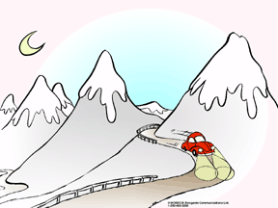
FOG
WHEN DRIVING IN FOG, USE LOW-BEAM HEADLIGHTS,
or
STOP, GET OFF THE ROADWAY, AND WAIT!!

Slide 14
!!! DANGER !!!
CARBON MONOXIDE POISONING
Each year 1,500 people are killed in the U.S. by carbon
monoxide, approximately 900 of whom die in their homes. More than 10,000 are exposed to levels so dangerous that medical attention is required.

Slide 15
CARBON MONOXIDE
Attributes/Effects
Odorless & Colorless
Nausea, Headache, Dizziness
Causes Drowsiness
CAN BE FATAL

Slide 16
CARBON MONOXIDE
Prevention
1. Never run engine in an enclosed area
2. Check exhaust (muffler) for leaks

Slide 17
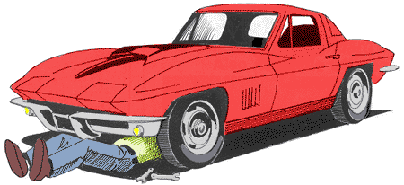
BEFORE TRIPS: CHECK
BATTERY
ANTIFREEZE
WIPERS & FLUID
IGNITION SYSTEM
THERMOSTAT
LIGHTS
HAZARD LIGHTS
EXHAUST SYSTEM
HEATER
BRAKES
DEFROSTER
OIL LEVEL

Slide 18
Brake System
To make an emergency stop on a slippery road…
Regular Brakes Pump the Brake Pedal.
Anti-lock Brakes (ABS)
Press down and hold.
The ABS will pump for you.

Slide 19
Drive System
Rear Wheel Drive Pushes
and
Front Wheel Drive Pulls
The systems may feel a little different, but always steer in the direction of the skid, and make gentle corrections to regain control.

Slide 20
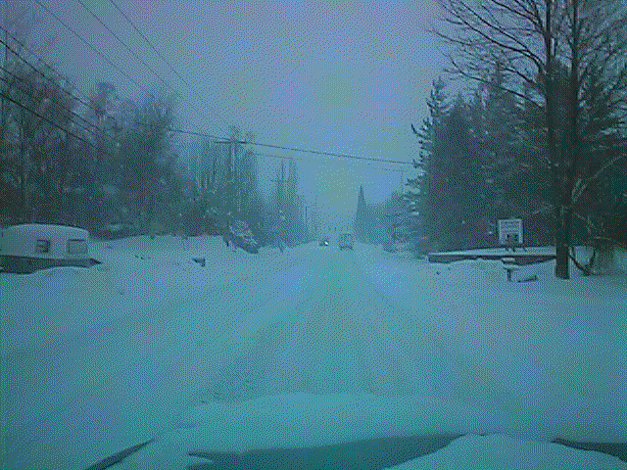
KEY DRIVING TIPS
ALLOW MORE TIME TO TRAVEL
MAINTAIN MORE SPACE
DRIVE WITH YOUR LIGHTS ON
WEAR SAFETY BELTS
LOOK WELL AHEAD
ANTICIPATE PROBLEMS

Slide 21
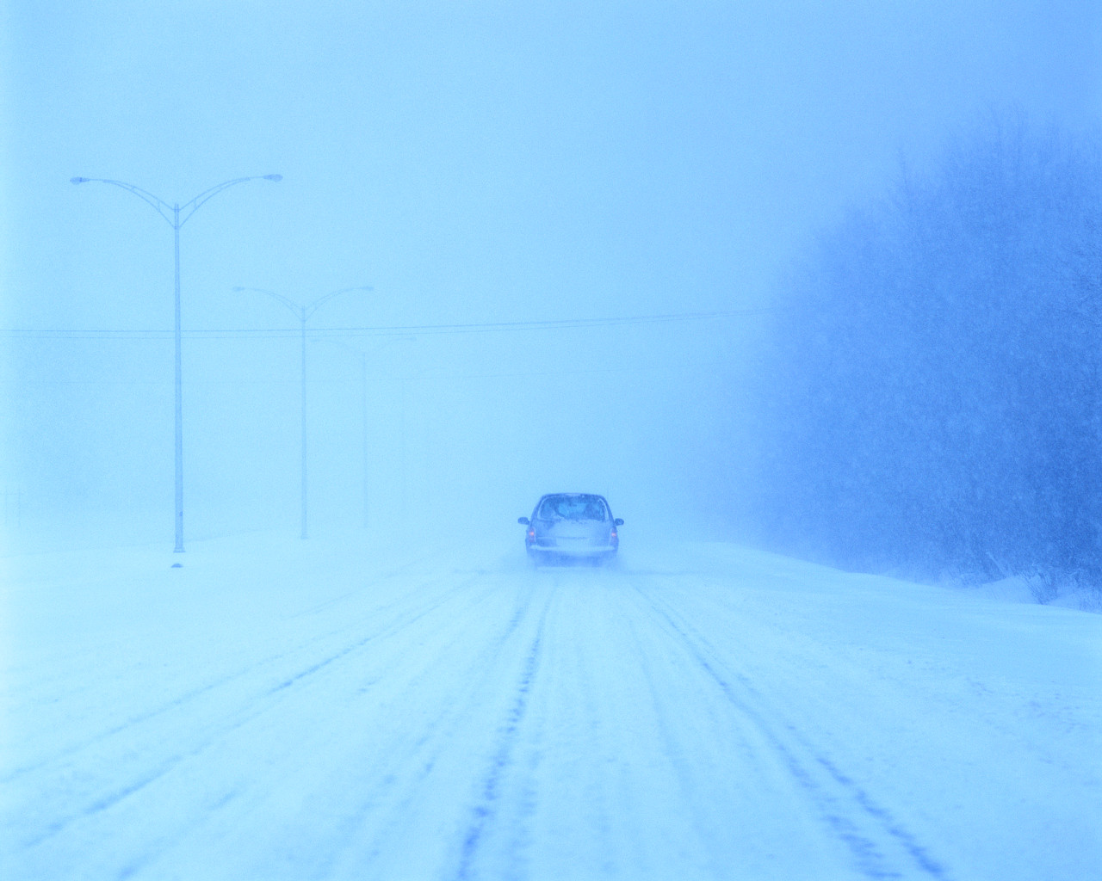

STUCK IN SNOW
CLEAR A PATH
STRAIGHTEN FRONT WHEELS
USE ABRASIVE MATERIALS UNDER WHEELS
GENTLE PRESSURE ON ACCELERATOR
DON’T SPIN WHEELS
“ROCKING THE VEHICLE” – CHECK OWNER’S MANUAL
LAST RESORT …

Slide 22
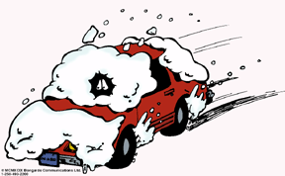
SUMMARY
REMEMBER THE THREE P’s
- PREPARE FOR THE TRIP
- PROTECT YOURSELF
- PREVENT CRASHES ON THE ROAD
SLOW DOWN!
GIVE DISTANCE
CLEAN OFF WINDOWS - SEE
CLEAN OFF ALL LIGHTS AND TURN
LIGHTS ON - BE SEEN

Slide 23
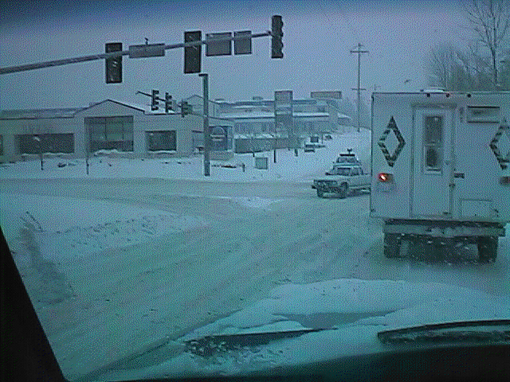
DRIVE TO ARRIVE ALIVE !

